Slide 1
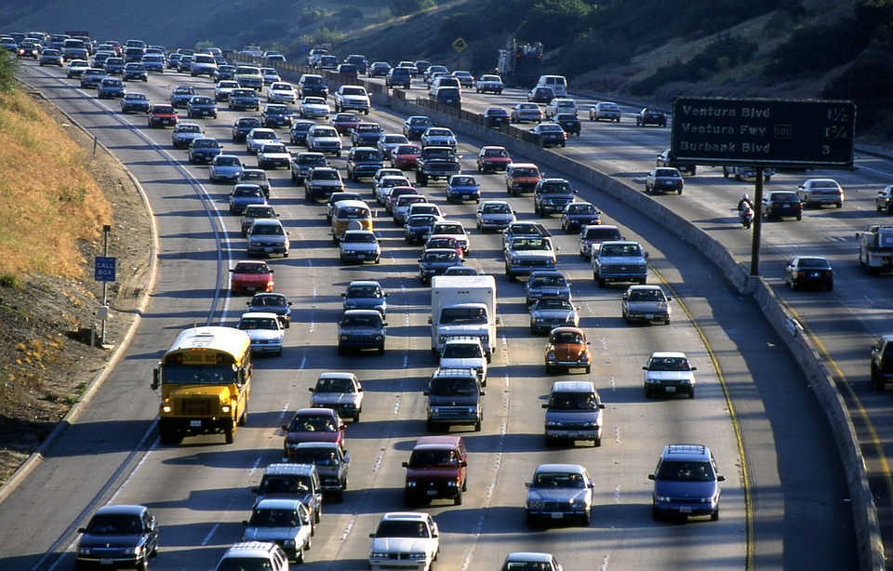
Road Accidents Analysis

Slide 2
Introduction
The road accidents data analysis examines key patterns, causes, and trends to identify critical risk factors.
By exploring data on accident frequency, locations, times, and contributing factors, the report aims to offer actionable insights for key stakeholders to enhance preventive measures, and reduce overall accident rates.

Slide 3
Analysis Process Steps
Define Objectives
Identify Data Source
Data Collection and Cleaning
Data Processing
Choose a Visualisation Tool
Design Layout
Create Visualisation
Add Interactivity
Test and Validate

Slide 4
Objective
The analysis aims to uncover the trends and patterns in the accidents occurrences with help of the following:
Total casualties taken place after the accident.
Total casualties and percentage of total with respect to accident severity and maximum casualties by type of vehicle.
Total casualties with respect to vehicle type.
Monthly trend showing comparison of casualties for the current year and previous year.
Casualties’ distribution on different road types and road surface conditions.
Variation in casualties depending on area and light conditions.

Slide 5
Stakeholders
Ministry of Transport
Road transport department
Police Force
Emergency Services Department
Road Safety Corps
Transport Operators and Mechanics
Traffic Management Agencies
Public
Media

Slide 6
Dataset & Technology
Dataset:
File type: .xlsx
307973 rows
Number of fields: 21
Fields list includes: Accident index, Accident date, Accident severity, Area, Light conditions, type of vehicle, type of road and road surface conditions, etc.
Technology used:
MS Excel

Slide 7
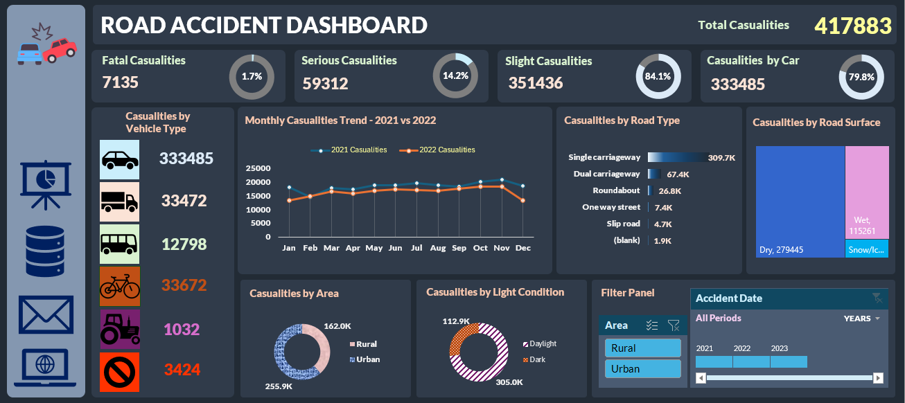
Dashboard

Slide 8
Conclusion
The total casualties amount to as high as 417883, which is alarmingly high.
Among the casualties, fatal casualties comprise 1.7% resulting in demise of 7135 individuals.
The maximum number of casualties occur by either cars, taxis or private hired cars. They comprise almost 80% of all the casualties.
The number of accidents have decreased from 2021 to 2022 in all the months except one.

Slide 9
Conclusion
Single carriageway type of road contributes to more accidents than all other type of roads combined.
There are more occurrences of accidents on dry surface conditions than on wet or snowy surfaces. So, the accidents may be due to machine failures or human negligence.
The maximum number of casualties occur in daylight which amount to around 75%.
The urban locale contribute to more number of casualties as compared to rural.

